Slide 1
AI MENTAL FITNESS TRACKER
CAPSTONE PROJECT
Presented By:
Name: Aman pandey
College name: Bharati Vidyapeeth Deemed University Department of Engineering & Technology, Navi Mumbai
Internship domain: Artificial Intelligence

Slide 2
OUTLINE
Problem Statement (Should not include solution)
Proposed System/Solution
System Development Approach (Technology Used)
Result
Conclusion
Future Scope
References

Slide 3
PROBLEM STATEMENT
The AI Mental Health Tracker addresses the difficulty of consistent mental health management by providing a real-time, personalized platform. It helps users monitor their emotional well-being, identify patterns, and receive tailored insights and recommendations. Using advanced analytics, it offers early alerts for potential issues, making mental health care more accessible and proactive.

Slide 4
PROPOSED SOLUTION
The AI Mental Fitness Tracker offers a unique and valuable solution to predict mental fitness levels. By leveraging advanced machine learning algorithms and incorporating various features, we provide accurate and objective assessments of mental well-being. Early detection of potential issues enables timely intervention, preventing the escalation of problems. Furthermore, our project contributes valuable data-driven insights to researchers. Overall, our solution enhances individual well-being and fosters a society that prioritizes mental fitness.

Slide 5
SYSTEM APPROACH
System requirements :
windows 11 operating system
16GB RAM, I5 Processor
Library required to build the model :
Pandas
NumPy
Matplotlib
Seaborn
Catplot
sklearn

Slide 6
ALGORITHM & DEPLOYMENT
Algorithm
Data Collection: Collect diverse data, including user behavior, social media activity, and personal information.
Data Integration: Combine and preprocess data from various sources to ensure consistency and accuracy.
Feature Extraction: Identify and extract relevant features such as mood trends, activity levels, and engagement metrics.
Model Selection and Training:
Linear Regression: Predict continuous variables like mood fluctuations.
Random Forest: Classify mental health conditions and handle complex interactions.
Decision Trees: Provide interpretable decision rules for mental health predictions.
Prediction and Assessment: Use the trained models to predict mental health states and assess risk levels.
Insights Generation: Analyze model outputs to provide actionable insights and recommendations.
Feedback Loop: Continuously refine models based on real-world data and user feedback to improve accuracy.

Slide 7
DEPLOYMENT
Deployment
Platform Selection: Choose the deployment platform (mobile app, web app) based on user needs and accessibility.
Backend Infrastructure: Set up servers and cloud services (e.g., AWS, Azure) to handle data processing and model execution.
Frontend Development: Design and develop the user interface for data input, visualization, and interaction.
Integration: Integrate machine learning models with backend systems and the frontend interface.
Testing: Conduct rigorous testing, including unit tests, integration tests, and user acceptance tests to ensure reliability and performance.
Deployment: Deploy the application to the chosen platform and monitor its performance.
Monitoring and Maintenance: Regularly monitor system performance, user feedback, and model accuracy. Update the application and models as needed.
Compliance and Security: Ensure compliance with data privacy regulations (e.g., GDPR, HIPAA) and implement strong security measures to protect user data.

Slide 8
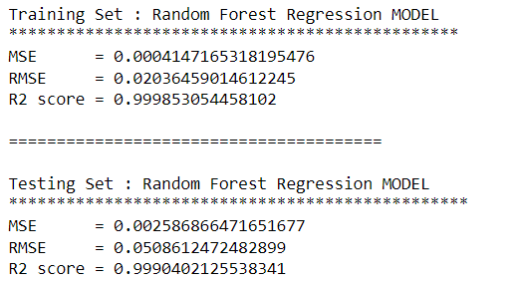
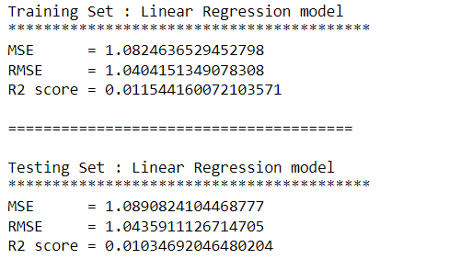
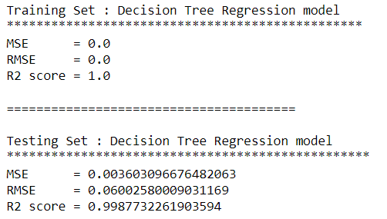
RESULT
Linear Regression model
Random Forest Regression model
Decision Tree Regression model

Slide 9
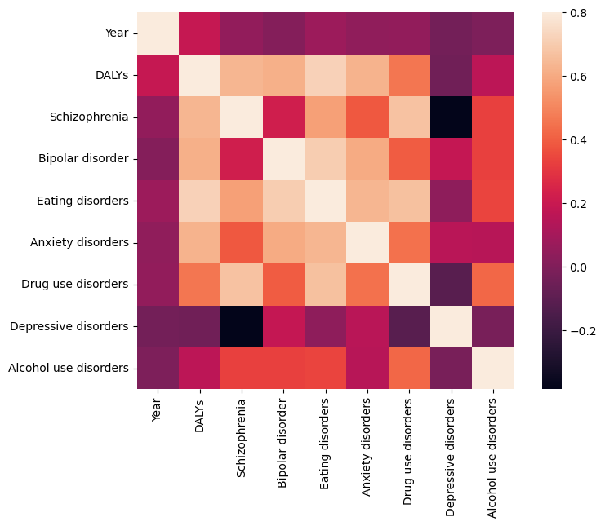
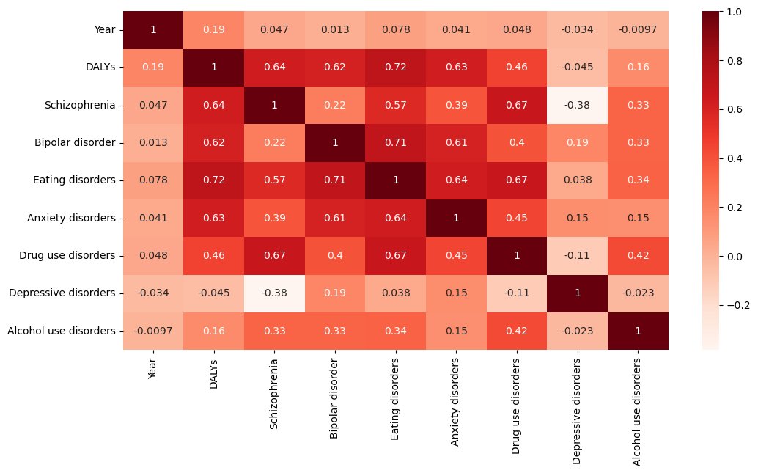
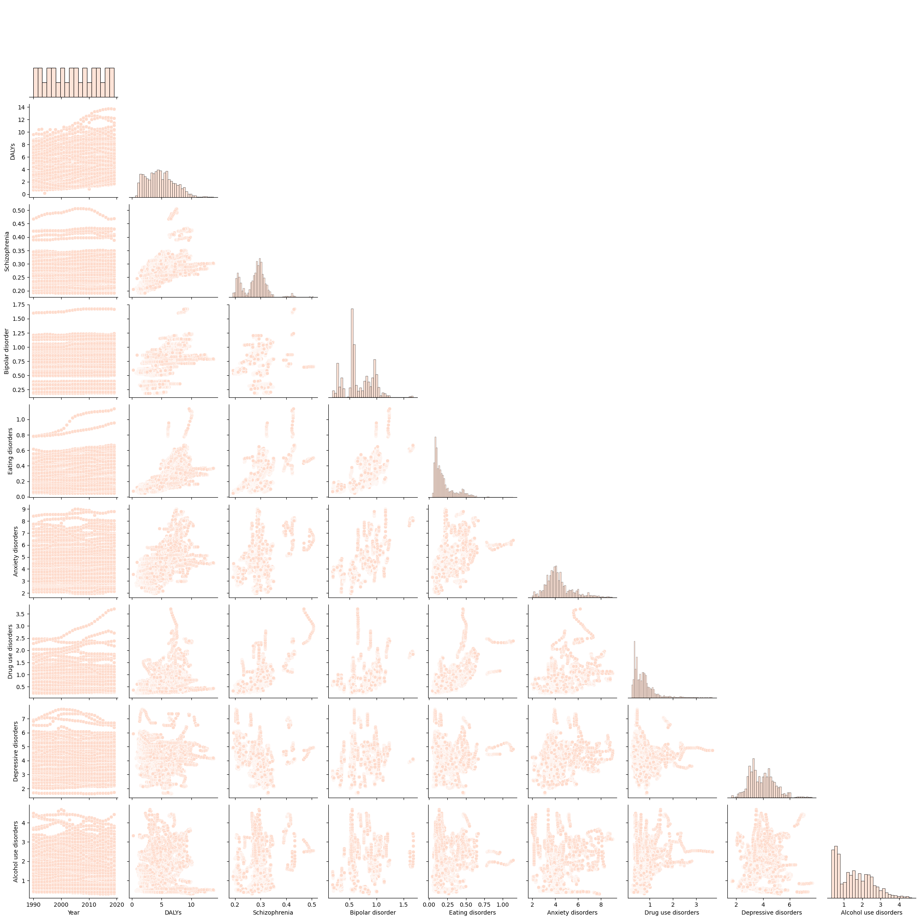
RESULT

Slide 10
CONCLUSION
The Linear Regression model's performance for both the training and testing sets is not particularly strong. The mean squared error (MSE) and root mean squared error (RMSE) indicate relatively high levels of error, while the R2 score suggests that only a small portion of the variance in the data is explained by the model.
The Random Forest Regression model shows excellent performance on both the training and testing sets. It achieves a high R2 score of around 0.999, indicating that it can explain a significant portion of the variance in the target variable. The mean squared error (MSE) and root mean squared error (RMSE) values are also low, suggesting good predictive accuracy. Overall, the model demonstrates strong performance in predicting the target variable.
The Decision Tree Regression model performed very well on both the training and testing sets. The MSE, RMSE, and R2 scores for the training set are all 0, which indicates that the model perfectly predicted the training data. The MSE and RMSE scores for the testing set are very small, and the R2 score is very close to 1, which indicates that the model also performed well on the testing data. Overall, the Decision Tree Regression model is a good choice for this regression task.
From the above 3 Models, RANDOM FOREST RERESSION MODEL & DECISION TREE REGRESSION MODEL will be a good choice for the given data files.

Slide 11
REFERENCES
https://www.javatpoint.com/artificial-intelligence-ai
https://www.javatpoint.com/machine-learning
https://www.geeksforgeeks.org/random-forest-regression-in-python/
https://www.geeksforgeeks.org/python-decision-tree-regression-using-sklearn/
https://www.javatpoint.com/linear-regression-in-machine-learning
Project Link : https://github.com/Amanpandey5677/ai_metal_fitness_tracker

Slide 12
FUTURE SCOPE
The future of the AI Mental Fitness Tracker includes advanced personalization, integration with wearables, and improved prediction through deep learning. It will expand data sources to include social media and environmental factors, enhance user engagement with gamification, and feature collaborative tools for healthcare integration. Ethical AI practices and robust data security will be prioritized, alongside globalization efforts for multilingual support and comprehensive health tracking.

Slide 13
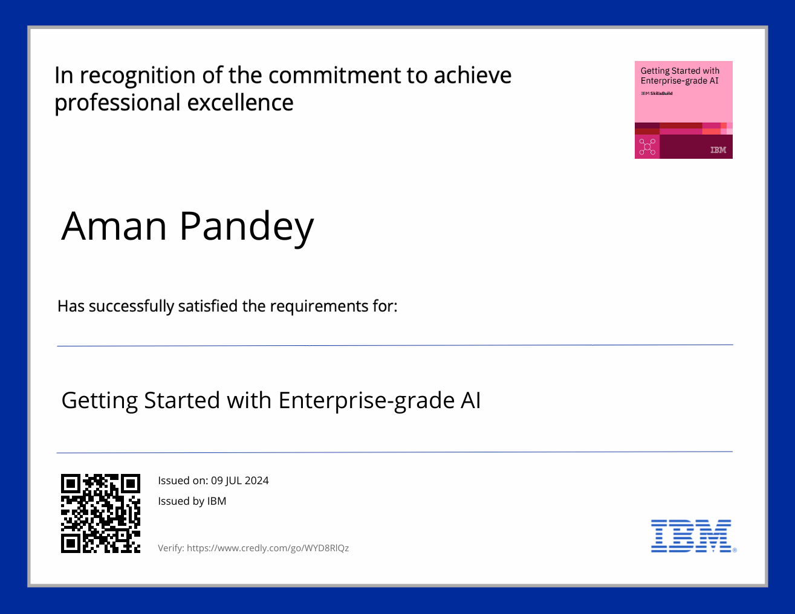

COURSE CERTIFICATE 1

Slide 14

COURSE CERTIFICATE 2

Slide 15
THANK YOU

